Slide 1
Capstone Project Presentation
AuE-8360 Scaled Autonomous Vehicles
Chinmay Samak
PhD Candidate, CU-ICAR
csamak@clemson.edu
Tanmay Samak
PhD Candidate, CU-ICAR
tsamak@clemson.edu
Course GitHub | Project GitHub

Slide 2
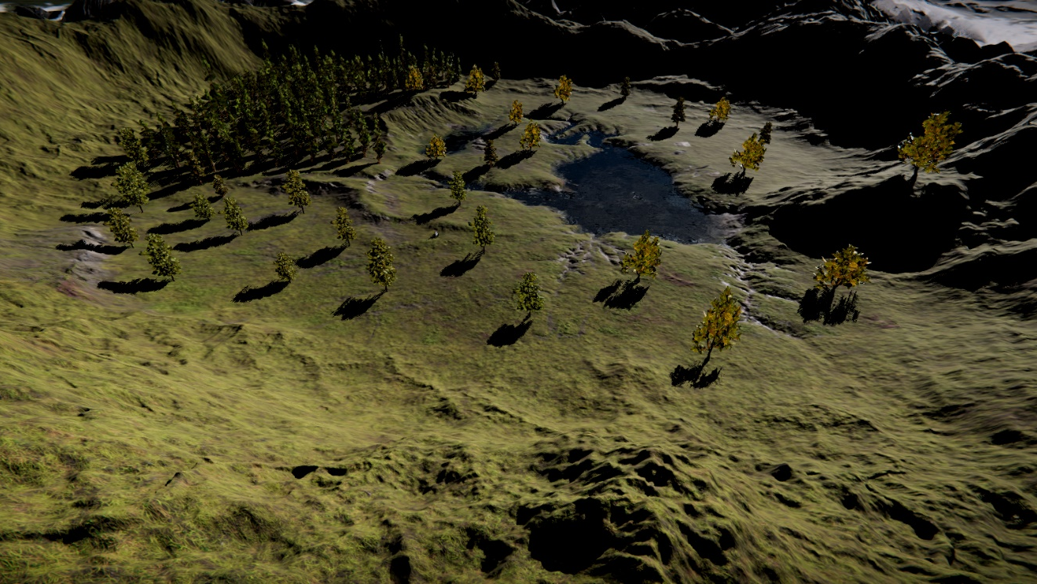
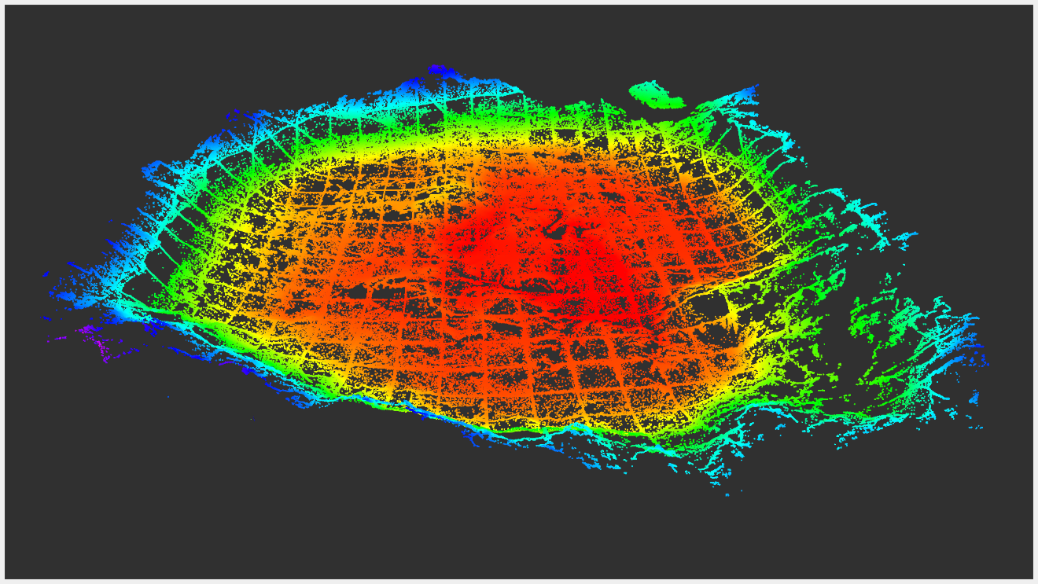
AutoDRIVE-Hunter-Autoware Integration
AutoDRIVE Simulator Demo (3D): PCD Map + Record + Replay
AutoDRIVE Simulator
RViz
Generate PCD map directly from within the simulator!

Slide 3
References
T. Samak, C. Samak, S. Kandhasamy, V. Krovi, and M. Xie, “AutoDRIVE: A Comprehensive, Flexible and Integrated Digital Twin Ecosystem for Autonomous Driving Research & Education,” Robotics, vol. 12, no. 3, p. 77, May 2023, doi: 10.3390/robotics12030077
W. Ding, C. Xu, M. Arief, H. Lin, B. Li and D. Zhao, “A Survey on Safety-Critical Driving Scenario Generation—A Methodological Perspective,” in IEEE Transactions on Intelligent Transportation Systems, vol. 24, no. 7, pp. 6971-6988, July 2023, doi: 10.1109/TITS.2023.3259322
M. Quigley, K. Conley, B. Gerkey, J. Faust, T. Foote, J. Leibs, R. Wheeler, and A. Ng, “ROS: an open-source Robot Operating System,” in ICRA 2009 Workshop on Open Source Software, vol. 3, Jan 2009. [Online]. Available: http://robotics.stanford.edu/~ang/papers/icraoss09-ROS.pdf
S. Macenski, T. Foote, B. Gerkey, C. Lalancette, and W. Woodall, “Robot operating system 2: Design, architecture, and uses in the wild,” Science Robotics, vol. 7, no. 66, p. eabm6074, 2022. [Online]. Available: https://www.science.org/doi/abs/10.1126/scirobotics.abm6074
Autoware Foundation, “Autoware Project: The world’s leading open-source software project for autonomous driving.” [Online]. Available: https://autoware.org

Slide 4
Thank You!
…Open to questions and discussion.

